Slide 1
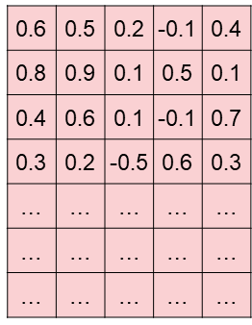

Model Summary – Model Structure
Input
‘我’, ‘吃了’, ‘美味’, ‘汉堡’, ‘非常’, ‘开心’, ‘哈哈’
Embedding
0.1 | -0.1
0.3 | 0.2
0.1 | 0.4
-0.5 | 0.6
0.2 | 0.7
0.87
Reshape
我
0.1 | -0.1
0.3 | 0.2
0.1 | 0.4
-0.5 | 0.6
0.2 | 0.7
0.68
吃了
0.18
Convolutional
美味
0.31
汉堡
0.5
MaxPooling
非常
0.43
开心
Flatten
哈哈
Dropout
ReLu
0.87
Dense
0.31
$$\hat{Y}$$
0.5
Dropout
Softmax
Dense

Slide 2
Model Summary – Model Structure
Input
‘i’, ‘ate’, ‘delicious’, ‘hamburger’, ‘so’, ‘happy’, ‘today’
Embedding
i
0.1 | -0.1
0.3 | 0.2
0.1 | 0.4
-0.5 | 0.6
0.2 | 0.7
0.87
Reshape
0.1 | -0.1
0.3 | 0.2
0.1 | 0.4
-0.5 | 0.6
0.2 | 0.7
0.68
ate
Convolutional
delicious
0.18
0.31
hamburger
MaxPooling
so
0.5
0.43
happy
Flatten
today
Dropout
ReLu
0.87
Dense
0.31
$$\hat{Y}$$
0.5
Dropout
Softmax
Dense

Slide 3
Model Summary – Model Structure
Concatenated
Flatten Layer
Embedding
Convolutional
MaxPooling
Flatten
Kernel size: 4
Convolutional
MaxPooling
Flatten
Fully
Connected
Layers
Input
Embedding
Kernel size: 6
Embedding
Convolutional
MaxPooling
Flatten
Kernel size: 8

